Slide 1
House Price Prediction
Presented by: Christoph Rendel
Elizabeth Shogbanmu
April 2022

Slide 2
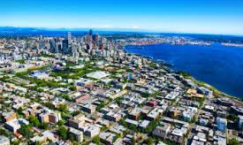
King County, Washington
Population- 2,269,675(Census 2020)-Most populated in Washington
Area-2,307 sq miles
490 square km water bodies
Highest Mountain- Mount Daniel 2,426m

Slide 3
Table of Contents
Introduction -Research Question
-Objective of Study
Data set
Data Processing Pipeline
Insights/Findings
Conclusion
Outlook

Slide 4
RESEARCH QUESTION/OBJECTIVE
DATA SET
The data set contains records of 21,597 houses sold in King County and 21 features
On the average, the house price for a 3bedroom house(which is the most common based on count) is $466,277
Price is the target variable and other features include structure and location.
What are the features that influence high property value?
To build a model that will predict the price of houses based on these features.

Slide 5
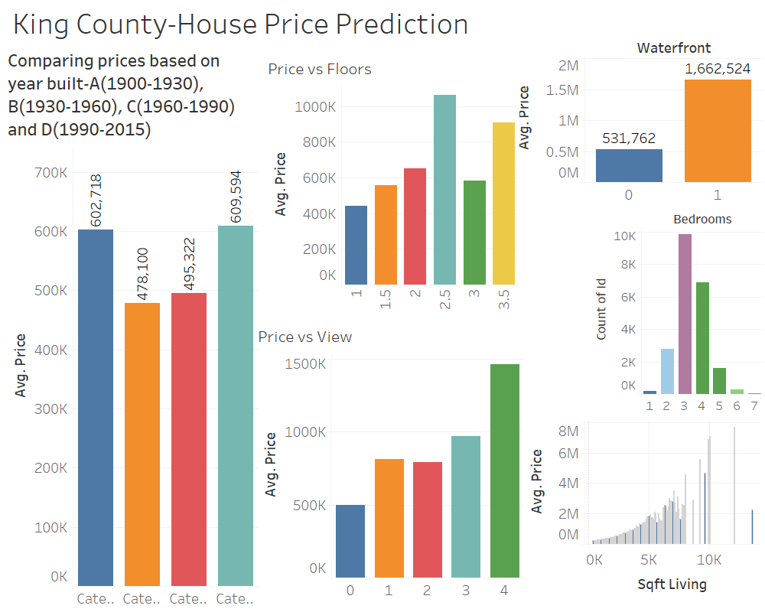
Data Overview

Slide 6
Data Pipeline
Data Source
Data Processing
Linear regression
Improving model by
removing non- significant features
Visualize Results

Slide 7
Data Transformation
Dropped: id, date, lat, long, sqft_above (multicolinearity)
Imported: Distance to city center
Binned:
Year renovated (Yes, No),
basement size (Yes, No),
Grade (average, above average),
Floors (one, more than one)

Slide 8
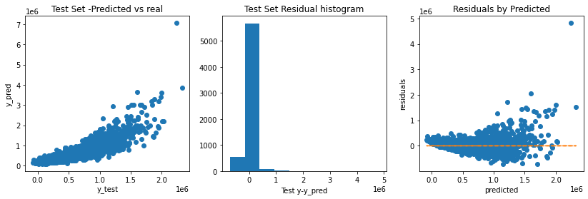
Model Results
 | R2_test | R2_train | Adj_R2
model 1 | 0.7554379531895128 | 0.7696525976580786 | 0.7526178911506988
model 2 | 0.7541199555529359 | 0.7693343591901028 | 0.751363452812498

Slide 9
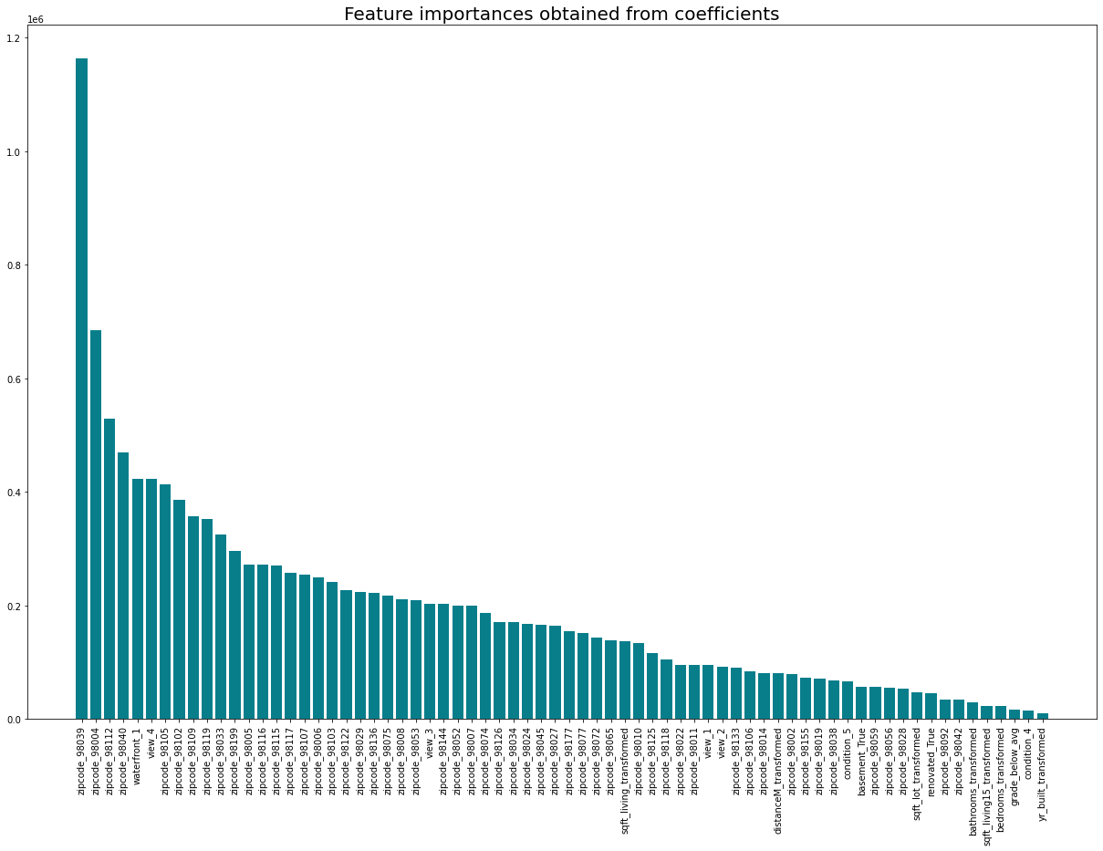

Slide 10
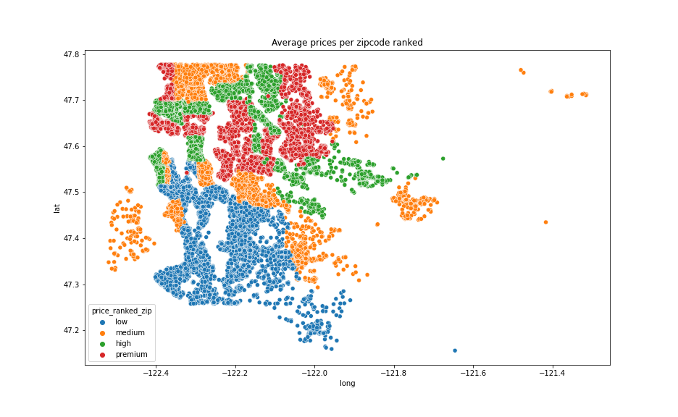
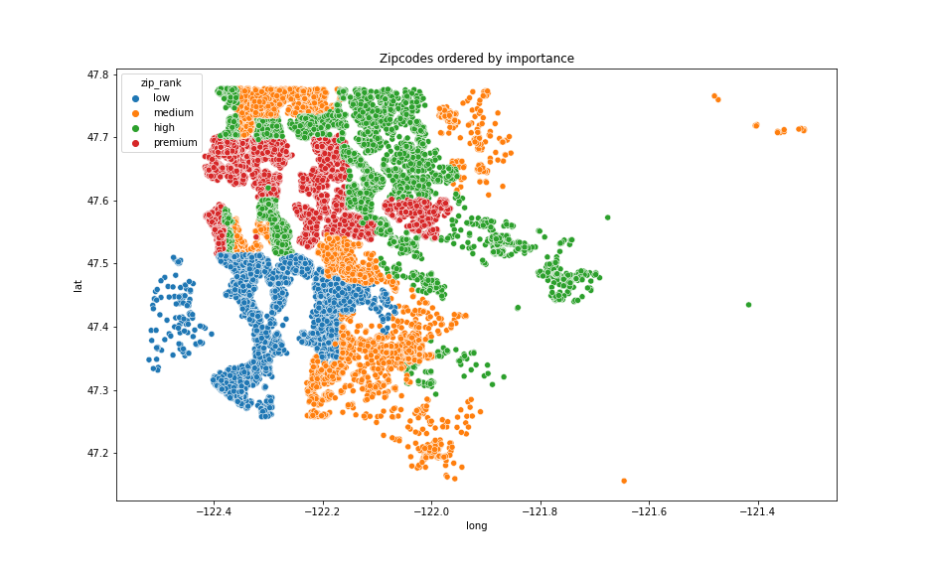
Is my neighbourhood overprices?
Zipcode most important predictor
Zoning of zipcodes
Define market value of your house
Interesting for:
Real estate companies
Investors (private and commerical)
City planers

Slide 11
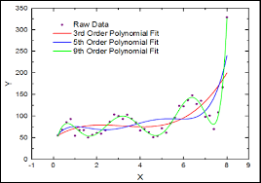
Outlook:
Conclusion
Location (zipcode, distance to center, view, waterfront) most relevant
Attributes of size are significant but with a smaller influence
Apply Polynomial regression
Apply model on dataset of different cities and areas
Exclude location effect
Add more attributes (crime rate, population growth…)

Slide 12
Thank You!

Slide 13
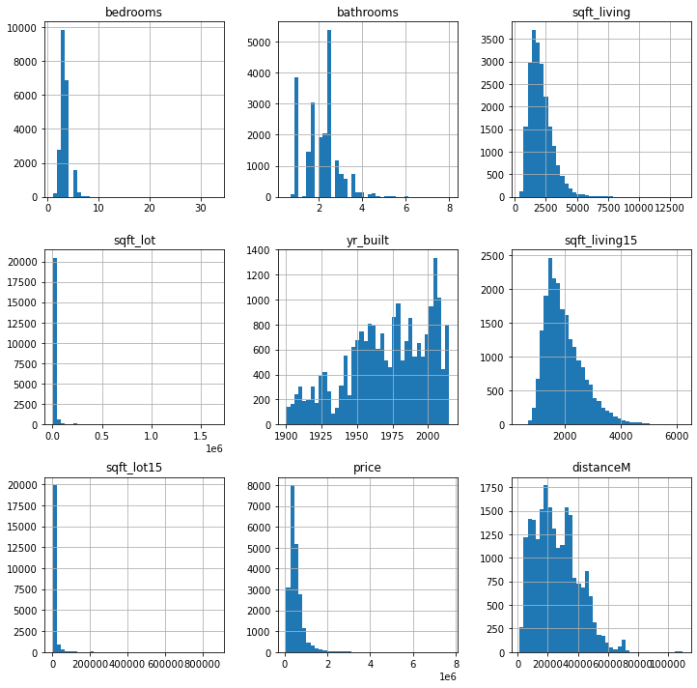
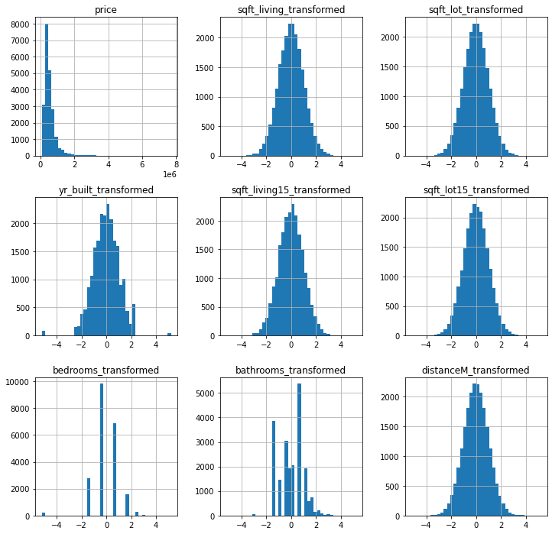
Before and After Modelling-Histograms

Slide 14
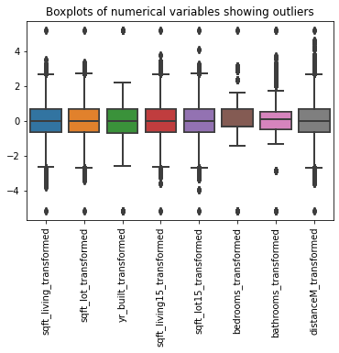
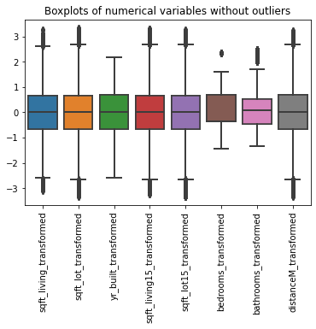
Removing Outliers

Slide 15
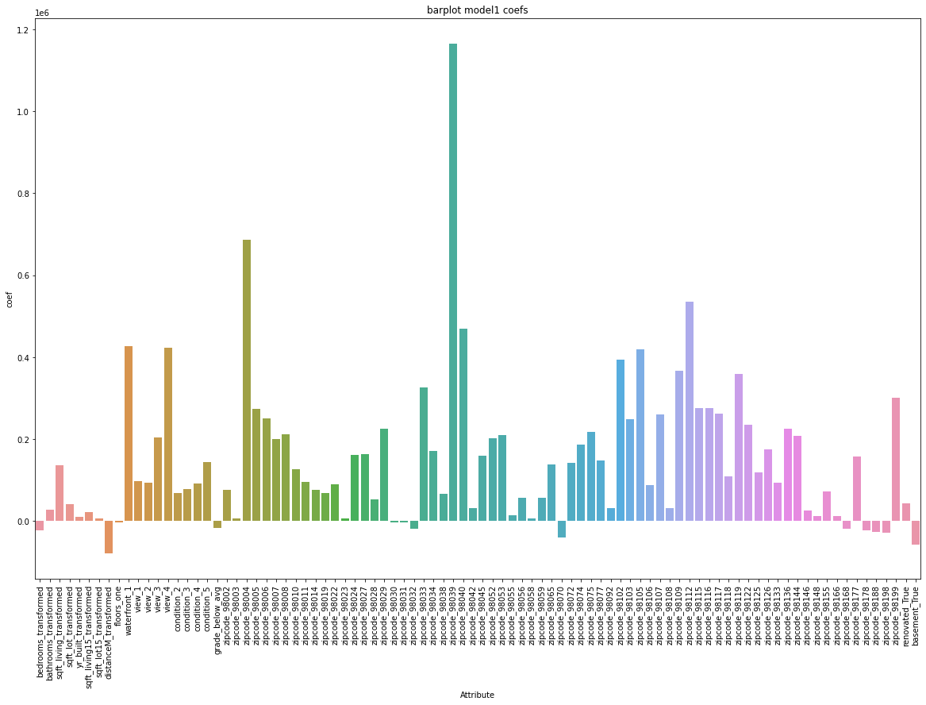

Slide 16
Thank You!

